Slide 1
Food
What reason would an author have for writing a scene in which the characters have a meal?
What are some famous meals fictionally or historically? What do they have in common?

Slide 2
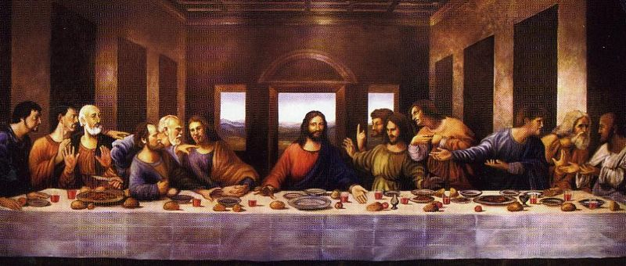
Food
Food ALWAYS (nearly at least) symbolizes communion. Does the picture below look familiar?

Slide 3
Food
Communion basically means coming together. Think of the word “community.”
Eating is a very personal act that you don’t want to do with just anyone. You could be poisoned! Someone could spit on your burger! It’s about sharing and we usually do this with people we know.

Slide 4
Food
Even though “The Last Supper” might be our cultural touchstone for communion, all communions in literature are not necessarily holy.
Shakespeare’s Titus Andronicus
Communion is about sharing an experience. It puts everyone on common ground. A king and a serf both have to eat!

Slide 5
Food
Then again, sometimes food is just food.
Still, if you were an author would you be interested in writing meal scenes just so we could watch someone eat?
How much fun do you have when you sit at a table and watch someone else eat?

Slide 6
“Cathedral” by Raymond Carver
Write three questions you have about the story.
In what ways does Carver use the idea of communion to further the meaning of the story (one page minimum)?
What other patterns or symbols do you think might be in play in the text? Explain.

